Slide 1
SWEG2031
Object Oriented Programming
Software Engineering Department
AASTU
November, 2017

Slide 2
Chapter 4
Inheritance

Slide 3
Objectives
To encapsulate data fields to make classes easy to maintain
To discuss the basic concept of inheritance
To introduce the notions of abstract methods, abstract classes, and interfaces.
To introduce issues that arise with subclasses - protected visibility, use of the super() constructor
To discuss the notion of multiple inheritance and Java’s approach to it

Slide 4
Content
Inheritance
Method overloading and overriding
Abstract classes and Interfaces

Slide 5
Fundamental OOP Concepts
Encapsulation is one of the fundamental OOP concepts. The other two are inheritance and polymorphism.
Encapsulation is combining data and behavior in one package and hiding the implementation details. It is the technique of making the fields in a class private and providing access to the fields via public methods.
Encapsulation is also referred to as data hiding.
Benefit: the ability to modify our implemented code without breaking the code of others who use our code.

Slide 6
OOP Concepts(cont’d)
In OO systems, the class is the basic unit of encapsulation.
For example, you can create a Circle object and find the area of the circle without knowing how the area is computed.
Benefits of Encapsulation
  A class can have total control over what is stored in its fields.
  The users of a class do not know how the class stores its data.
  The fields of a class can be made read-only or write-only.

Slide 7
Encapsulation(Example)
  public class EncapTest{
    private String name;
    private String idNum;
    private int age;
  public int getAge(){
  return age;
  }
  publicString getName(){
  return name;
  }
  publicString getIdNum(){
  return idNum;
  }

Slide 8
Example(cont’d)
  publicvoid setAge(int newAge){
  age = newAge;
  }
  publicvoid setName(String newName){
  name = newName;
  }
  public void setIdNum(String newId){
  idNum = newId;
  }
  }

Slide 9
Example(cont’d)
  public class RunEncap{
  public static void main(String args[]){
  EncapTest encap =new EncapTest();
  encap.setName("James");
  encap.setAge(20);
  encap.setIdNum("12343ms");
  System.out.print("Name : "+ encap.getName()+" Age : "+ encap.getAge());
  }
  }
Output
  Name: James Age:20

Slide 10
Inheritance
Inheritance can be defined as the process where one object acquires the properties of another.
It allows you to derive new classes from existing classes.
Allows reusing software.
E.g.
  Suppose you want to design the classes to model geometric objects such as circles and rectangles.
  Geometric objects have many common properties and behaviors: can be drawn in a certain color, filled or unfilled. Thus a general class GeometricObject can be used to model all geometric objects.
To avoid redundancy and make the system easy to comprehend and easy to maintain use inheritance.

Slide 11
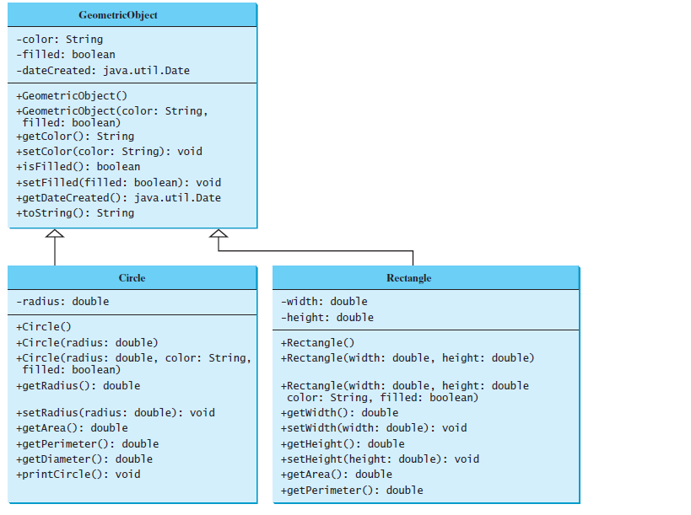
Inheritance(cont’d)
The GeometricObject class is the superclass for Circle and Rectangle

Slide 12
Inheritance(cont’d)
One of the main uses of inheritance is to model hierarchical structures that exist in the world.
Example: Consider people at AASTU. Broadly speaking, they fall into two categories: employees and students.
  There are some features that both employees and students have in common - whether a person is an employee or a student, he or she has a name, address, date of birth, etc.
  There are also some features that are unique to each kind of person e.g. an employee has a pay rate, but a student does not; a student has a GPA, but an employee does not, etc.

Slide 13
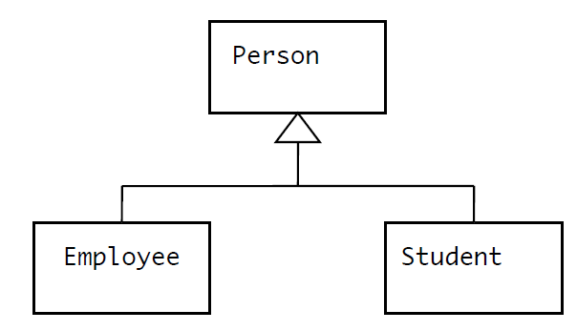
Inheritance(cont’d)
We can represent this hierarchical structure this way

Slide 14
Inheritance(cont’d)
With this structure, the classes Employee and Student inherit all the features of the class Person.
In addition, each of the classes Employee and Student can have features of its own not shared with the other classes.
To inherit a class, you simply incorporate the definition of one class into another by using the extends keyword.
For example, we could declare classes Person, Employee, and Student as follows:
  class Person {
  ...
  }
  class Employee extends Person {
  ...
  }
  class Student extends Person {
  ...
  }

Slide 15
Inheritance(cont’d)
public class Animal{
}
public class Mammal extends Animal{
}
public class Reptile extends Animal{
}
public class Dog extends Mammal{
}
Now, based on the above example, in Object Oriented terms the following are true:
  Animal is the superclass of Mammal class.
  Animal is the superclass of Reptile class.
  Mammal and Reptile are subclasses of Animal class.
  Dog is the subclass of both Mammal and Animal classes
A subclass and its superclass must have the is-a relationship
  Now, if we consider the IS-A relationship, we can say:
    Mammal IS-A Animal
    Reptile IS-A Animal
    Dog IS-A Mammal
    Hence : Dog IS-A Animal as well

Slide 16
Inheritance(cont’d)
Basic terminology: If a class B inherits from a class A:
  We say that B extends A or B is a subclass of A - So we say Employee extends Person, or Employee is a subclass of Person.
  We say that A is the base class of B or the superclass of B - So we say Person is the base class of Employee, or the superclass of Employee.
A key aspect of inheritance is that a subclass inherits all the features of its base class except for the private properties of the superclass.
    A subclass is not a subset of its super-class. In fact, a subclass usually contains more information and methods than its superclass.

Slide 17
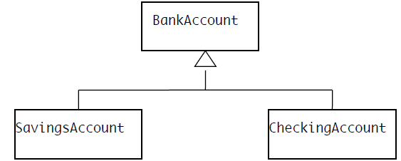
Inheritance(cont’d)
Consider the following example of a class hierarchy for bank accounts.
Observe the following:
  The classes SavingsAccount and CheckingAccount inherit the features of BankAccount
    a) Since a BankAccount has an owner and a balance, so does a SavingsAccount or a CheckingAccount.
    b) Since a BankAccount has methods deposit(), reportBalance(), and getAccountNumber(), so does a SavingsAccount or a CheckingAccount.

Slide 18
Inheritance(cont’d)
  Savings account adds features that an ordinary BankAccount does not have - e.g. payInterest() and setInterestRate().
  CheckingAccount overrides the withdraw() method of BankAccount.
    a) In the special case where the checking account balance is insufficient for the withdrawal, but the customer has a savings account with enough money in it, the withdrawal is made from savings instead.
    b) In all other cases, the inherited behavior is used by invoking super.withdraw(amount).

Slide 19
Inheritance(cont’d)
In designing a class hierarchy, methods should be placed at the appropriate level. For example, in the BankAccount Example:
  deposit(), reportBalance(), and getAccountNumber() are defined in the base class BankAccount, and so are inherited by the two subclasses.
  If they were defined in the subclasses, we would have to repeat the code twice - extra work and an invitation to inconsistency.
  On the other hand, payInterest() and setInterestRate() are defined in SavingsAccount, because they are not relevant for CheckingAccounts.
  withdraw() is defined in BankAccount and overridden in CheckingAccount. Why is this better than simply defining separate versions in CheckingAccount and SavingsAcccount?

Slide 20
Types of Inheritance
On the basis of class, there can be three types of inheritance in java: single, multilevel and hierarchical.
In java programming, multiple and hybrid inheritance is supported through interface only.

Slide 21
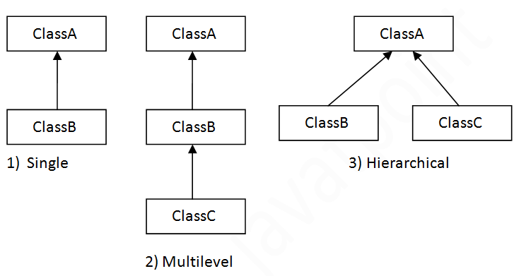
Types of Inheritance(cont’d)

Slide 22
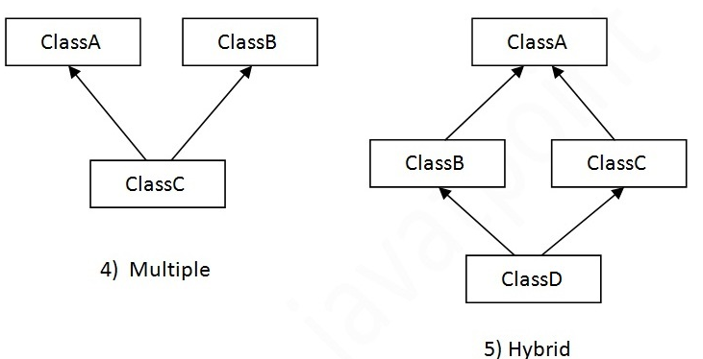
Types of Inheritance(cont’d)

Slide 23
Example: Single
  // A simple example of inheritance.
  // Create a superclass.
  class A {
  int i, j;
  void showij() {
  System.out.println("i and j: " + i + " " + j);
  }
  }
  // Create a subclass by extending class A.
  class B extends A {
  int k;
  void showk() {
  System.out.println("k: " + k);
  }
  void sum() {
  System.out.println("i+j+k: " + (i+j+k));
  }
  }

Slide 24
Example(cont’d)
  class SimpleInheritance {
  public static void main(String args[]) {
  A superOb = new A();
  B subOb = new B();
  // The superclass may be used by itself.
  superOb.i = 10;
  superOb.j = 20;
  System.out.println("Contents of superOb: ");
  superOb.showij();
  System.out.println();

Slide 25
Example(cont’d)
  /* The subclass has access to all public members of
  its superclass. */
  subOb.i = 7;
  subOb.j = 8;
  subOb.k = 9;
  System.out.println("Contents of subOb: ");
  subOb.showij();
  subOb.showk();
  System.out.println();
  System.out.println("Sum of i, j and k in subOb:");
  subOb.sum();
  }
  }

Slide 26
Example(cont’d)
The output from this program is shown here:
Contents of superOb:
i and j: 10 20
Contents of subOb:
i and j: 7 8
k: 9
Sum of i, j and k in subOb:
i+j+k: 24

Slide 27
Exercise
If you have identified the following three classes: Taxi, Truck, & Automobile, how do you design the classes using inheritance concept?

Slide 28
Method overloading
Methods of the same name can be declared in the same class, as long as they have different sets of parameters. This is called method overloading.
Method overloading is commonly used to create several methods with the same name that perform the same or similar tasks, but on different types or different numbers of arguments.
Method calls cannot be distinguished by return type if they have the same number and type of parameters.
  E.g. If we define method: public int square(int no);
  It is not allowed to define another method like this:
  public double square(int no);

Slide 29
Example
  public class MethodOverload{
  // test overloaded square methods
  public void testOverloadedMethods(){
  System.out.printf( "Square of integer 7 is " +square( 7 ) );
  System.out.printf( "Square of double 7.5 is" + square( 7.5 ) );
  }
  public int square( int intValue ){
  System.out.printf( "Called square with int argument:" +intValue );
  return intValue * intValue;
  }
  public double square( double doubleValue ){
  System.out.printf( "\nCalled square with double argument:" +doubleValue );
  return doubleValue * doubleValue;
  }
  }

Slide 30
Example(cont’d)
public class MethodOverloadTest{
public static void main( String args[] ){
MethodOverload methodOverload = new MethodOverload();
methodOverload.testOverloadedMethods();
}
}

Slide 31
Method overriding
Overriding means to provide a new implementation for a method in the subclass.
To override a method, the method must be defined in the subclass using the same signature and the same return type
Benefit of overriding is ability to define a behavior that's specific to the subclass type which means a subclass can implement a parent class method based on its requirement.

Slide 32
Example1
  class Animal{
  public void move(){
  System.out.println("Animals can move");
  }
  }
  class Dog extends Animal{
  public void move(){
  System.out.println("Dogs can walk and run");
  }
  }

Slide 33
Example1(cont’d)
  public class TestDog{
  public static void main(String args[]){
  Animal a =new Animal();// Animal reference and object
  Animal b =new Dog();// Animal reference but Dog object
  a.move();// runs the method in Animal class
  b.move();//Runs the method in Dog class
  }
  }
Program Output
  Animals can move
  Dogs can walk and run

Slide 34
Example 2
  class Animal2{
  public void move(){
  System.out.println("Animals can move");
  }
  }
  class Dog2 extends Animal2{
  public void move(){
  System.out.println("Dogs can walk and run");
  }
  public void bark(){
  System.out.println("Dogs can bark");
  }
  }

Slide 35
Example2(cont’d)
  public class TestDog2{
  public static void main(String args[]){
  Animal2 a =new Animal2();// Animal reference and object
  Animal2 b =new Dog2();// Animal reference but Dog object
  a.move();// runs the method in Animal class
  b.move();//Runs the method in Dog class
  b.bark();
  }
  }
Program output:
  TestDog.java:30: cannot find symbol
  symbol : method bark()
  location: class Animal
  b.bark();
  ^
  This program will throw a compile time error since b's reference type Animal doesn't have a method by the name of bark

Slide 36
Rules for method overriding
The argument list should be exactly the same as that of the overridden method.
The return type should be the same
The access level cannot be more restrictive than the overridden method's access level. For example, if the superclass method is declared public, then the overriding method in the subclass cannot be either private or protected.
Instance methods can be overridden only if they are inherited by the subclass.
A method declared static cannot be overridden.
A subclass within the same package as the instance's superclass can override any superclass method that is not declared private
A subclass in a different package can only override methods declared public or protected.

